Slide 1
Least Squares
Regression Line

Slide 2
Topics
Least squares regression line (LSRL)
Slope and y-intercept
Predictions using the LSRL
Dangers of prediction

Slide 3
Topics
Least squares regression line (LSRL)
Slope and y-intercept
Predictions using the LSRL
Dangers of prediction

Slide 4
Correlation vs Regression
Correlation measures the strength and direction of the relationships.
A regression line summarizes the relationship between two variables, but only in a specific setting: when one variable helps explain the other.
!!!! !!!! !!!! !!!! !!!! !!!! !!!! !!!! !!!! !!!! !!!! !!!! !!!! !!!! !!!! !!!! !!!! !!!! !!!! !!!! !!!! !!!! !!!! !!!!
You can not take a y and solve backwards for x. Algebraically it is possible but statistically you can not.
!!!! !!!! !!!! !!!! !!!! !!!! !!!! !!!! !!!! !!!! !!!! !!!! !!!! !!!! !!!! !!!! !!!! !!!! !!!! !!!! !!!! !!!! !!!! !!!!

Slide 5
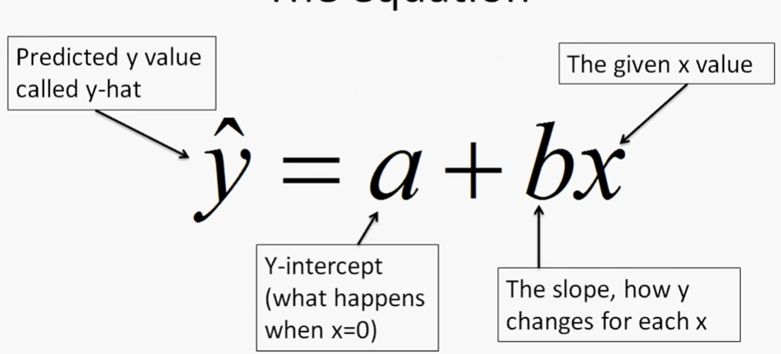
Definition:
A simple linear regression model is an equation that uses an explanatory variable, x, to predict the response variable, y.

Slide 6
Is attendance the solution?
High
Low Attendance
Will raising attendance also raise scores?
?
High
Low Scores

Slide 7
Linear Regression
Percent Attendance | STAAR Algebra 1 Raw Score
95 | 45
89 | 42
67 | 31
98 | 51
99 | 49
76 | 38
92 | 46
91 | 41
76 | 35
85 | 39
82 | 37
Random sample of students who took the Texas STAAR state Algebra 1 assessment and their attendance rate during the school year.
Regression, unlike correlation, requires that we have an explanatory variable and a response variable.

Slide 8
Linear Regression
Percent Attendance | STAAR Algebra 1 Raw Score
95 | 45
89 | 42
67 | 31
98 | 51
99 | 49
76 | 38
92 | 46
91 | 41
76 | 35
85 | 39
82 | 37
Random sample of students who took the Texas STAAR state Algebra 1 assessment and their attendance rate during the school year.
Will raising attendance also raise scores?

Slide 9
explains
responds
Linear Regression
Percent Attendance | STAAR Algebra 1 Raw Score
95 | 45
89 | 42
67 | 31
98 | 51
99 | 49
76 | 38
92 | 46
91 | 41
76 | 35
85 | 39
82 | 37
Random sample of students who took the Texas STAAR state Algebra 1 assessment and their attendance rate during the school year.

Slide 10
explains
responds
Linear Regression
Percent Attendance (x) | STAAR Algebra 1 Raw Score (y)
95 | 45
89 | 42
67 | 31
98 | 51
99 | 49
76 | 38
92 | 46
91 | 41
76 | 35
85 | 39
82 | 37
Random sample of students who took the Texas STAAR state Algebra 1 assessment and their attendance rate during the school year.
Explanatory (x): Attendance
Response (y): Test Scores

Slide 11
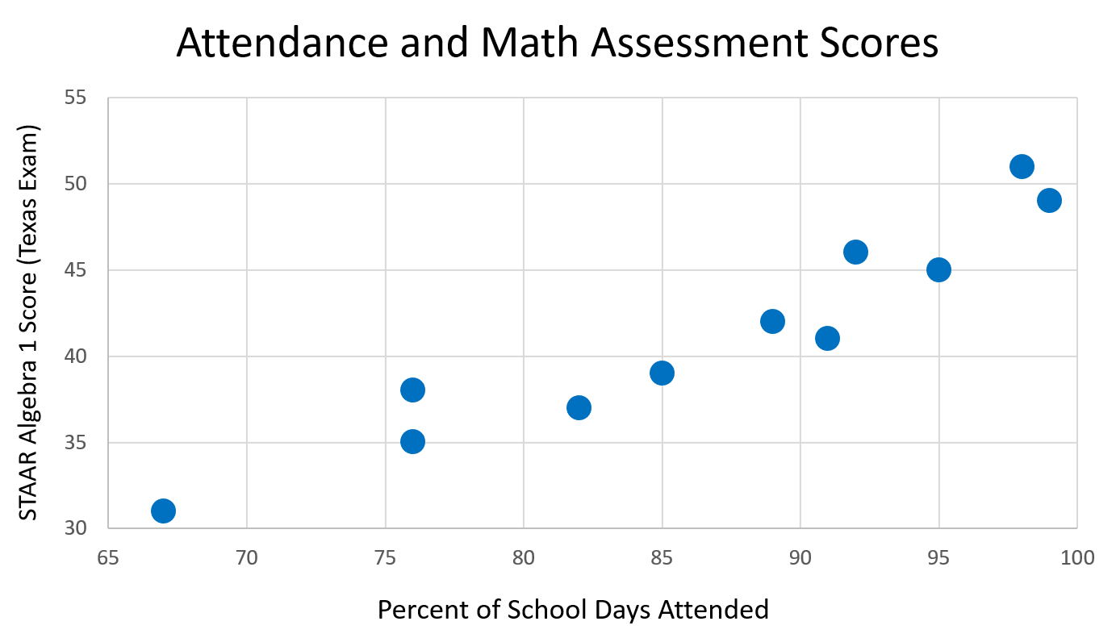

Slide 12
D: Positive
O: None
F: Linear
S: Strong

Slide 13
When a scatterplot shows a linear relationship, we can summarize the overall pattern by drawing a line on the scatterplot.
D: Positive
O: None
F: Linear
S: Strong
Notes:
A regression line summarizes the relationship between two variables, but only in a specific setting: when one variable helps explain the other.

Slide 14
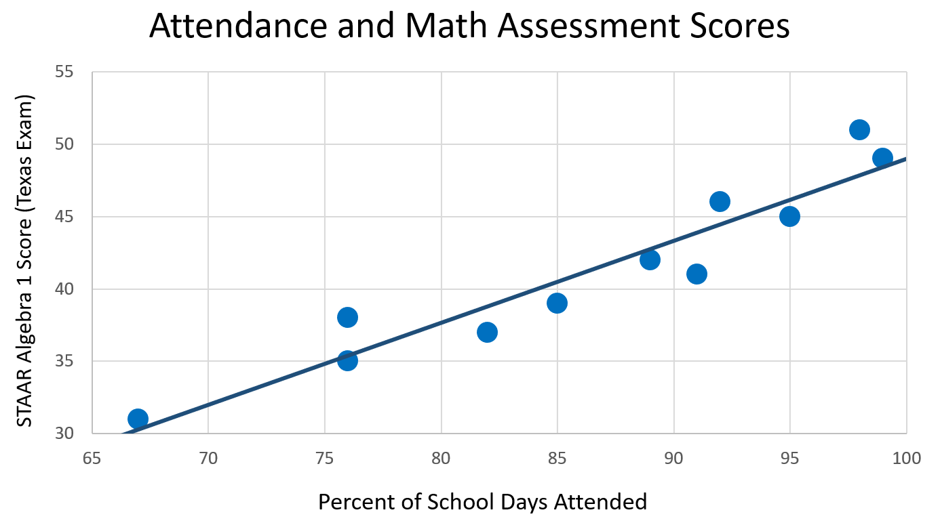
How do we find the least squares regression line (LSRL)?

Slide 15
Least Squares Regression

Slide 16
Least Squares Regression
Model A

Slide 17
Least Squares Regression
Model B

Slide 18
Least Squares Regression
Model A

Slide 19
Least Squares Regression
Model B

Slide 20
Least Squares Regression
Model A

Slide 21
Least Squares Regression
Model B

Slide 22
Model A
Model B

Slide 23
Model A
Which model fits better?
Model B

Slide 24
Residual

Slide 25
(7, 5)
(7, 5)
Residual

Slide 26
(7, 5)
(7, 3)
(7, 5)
Residual

Slide 27
(7, 5)
(7, 3)
(7, 5)
Residual：
how far off the predicted y is from the actual y value.
(7, 4)

Slide 28
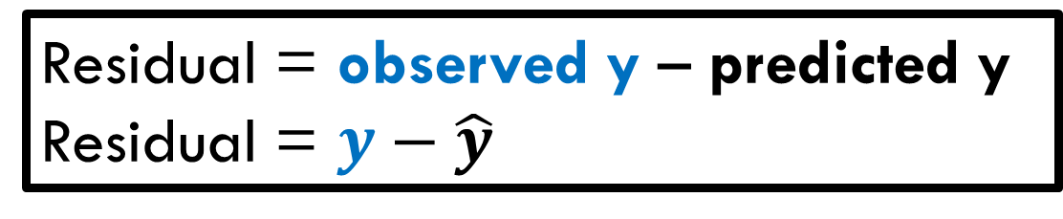
(7, 5)
(7, 3)
Residual = observed y – predicted y
Residual = $y−\hat{y}$
(7, 5)
Residual
(7, 4)

Slide 29
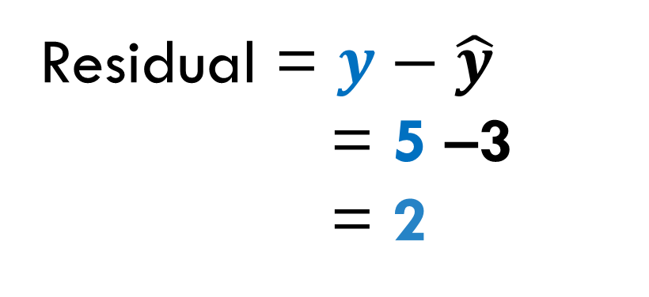
(7, 5)
(7, 3)
Residual = $y−\hat{y}$
= 5 –3
= 2
(7, 5)
(7, 4)

Slide 30
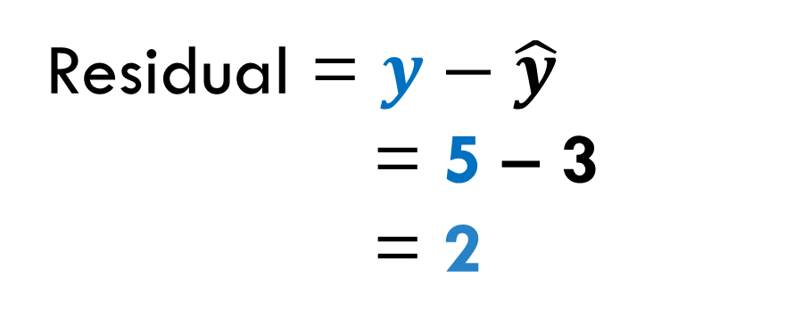
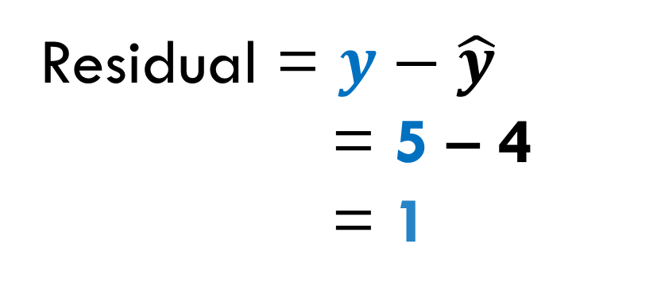
(7, 5)
(7, 3)
Residual = $y−\hat{y}$
= 5 – 3
= 2
Residual = $y−\hat{y}$
= 5 – 4
= 1
(7, 5)
(7, 4)
Each point on the scatterplot has its own residual value.

Slide 31
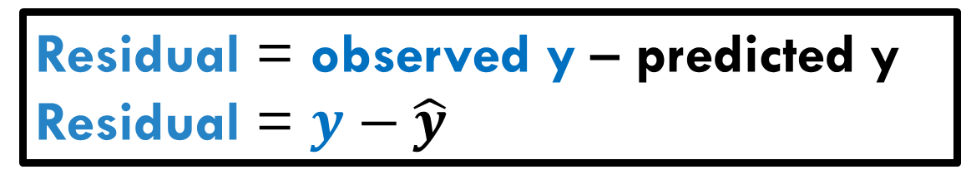
(9, 4)
(9, 3)
Residual = observed y – predicted y
Residual = $y−\hat{y}$

Slide 32
(9, 4)
(9, 3)
Residual = observed y – predicted y
Residual = $y−\hat{y}$
(9, 7)
(9, 3)

Slide 33
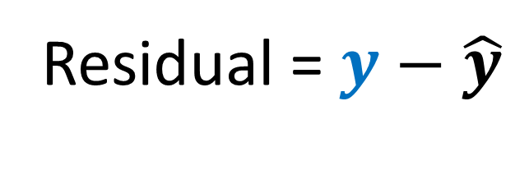
(9, 4)
(9, 3)
Residual = $y−\hat{y}$
(9, 7)
(9, 3)

Slide 34
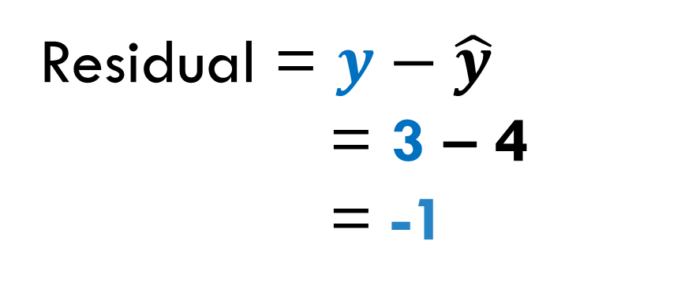
(9, 4)
(9, 3)
Residual = $y−\hat{y}$
= 3 – 4
= -1
(9, 7)
(9, 3)

Slide 35

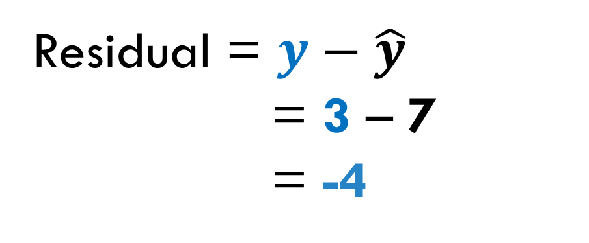
(9, 4)
(9, 3)
Residual = $y−\hat{y}$
= 3 – 4
= -1
(9, 7)
Residual = $y−\hat{y}$
= 3 – 7
= -4
(9, 3)

Slide 36
First thought: The line of best fit is the line that minimizes the sum of the residuals.

Slide 39
Sum of residuals: 0 + 0 + 0 = 0

Slide 40
Sum of residuals: 0 + 0 + 0 = 0
Good fit.

Slide 42
-2
0
+2

Slide 43
-2
0
+2
Sum of residuals: 2 + 0 + (-2) = 0

Slide 44
-2
0
+2
Sum of residuals: 2 + 0 + (-2) = 0
Good fit?!

Slide 45
-2
0
+2

Slide 47
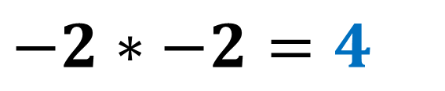
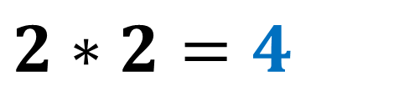
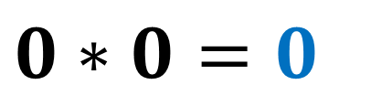
$$−2∗−2=4$$
$$0∗0=0$$
$$2∗2=4$$

Slide 50



$$−2∗−2=4$$
$$0∗0=0$$
$$2∗2=4$$

Slide 51



$$−2∗−2=4$$
$$0∗0=0$$
$$2∗2=4$$
$$0∗0=0$$
$$0∗0=0$$
$$0∗0=0$$

Slide 52
$$−2∗−2=4$$
$$0∗0=0$$
Sum of squared residuals
4 + 0 + 4 = 8
Not a great fit
$$2∗2=4$$
$$0∗0=0$$
$$0∗0=0$$
Sum of squared residuals
0 + 0 + 0 = 0
Great fit!
$$0∗0=0$$

Slide 53
Least Squares Regression Line (LSRL): a linear model that minimizes the sum of the square residuals between the data and the model.
Also called “line of best fit”

Slide 54
How do we find the least squares regression line (LSRL)?

Slide 58
Calculator steps

Slide 59
Topics
Least squares regression line (LSRL)
Slope and y-intercept
Predictions using the LSRL
Dangers of prediction

Slide 60
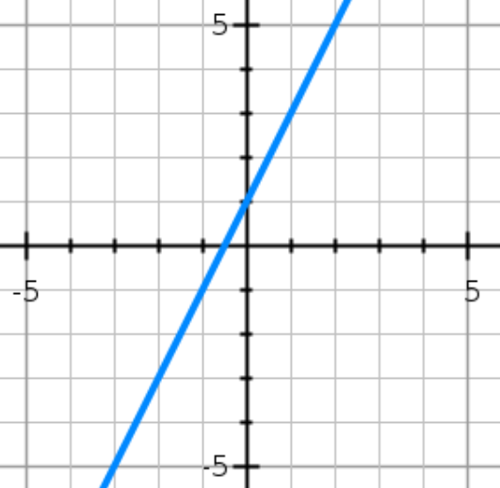
y = ax + b
y = 2x + 1
Slope? What does it mean?
Y intercept? What does it mean?

Slide 61
y = ax + b
y = 2x + 1
Slope? What does it mean?
Y intercept? What does it mean?
+1

Slide 62
y = ax + b
y = 2x + 1
Slope? What does it mean?
Y intercept? What does it mean?
+2
+1

Slide 63
y = ax + b
y = 2x + 1
Slope? What does it mean?
Y intercept? What does it mean?
+2
+1

Slide 64
y = ax + b
y = 2x + 1
Slope? What does it mean?
Slope: 2
For every increase in x by 1 unit, the y values increase by 2.
Y intercept? What does it mean?
+2
+1

Slide 65

$$\hat{y}=ax+b$$
slope: a
The slope tells us how the predicted y-variable changes as the x-variable increased by one unit.

Slide 66
y = ax + b
y = 2x + 1
Slope? What does it mean?
Slope: 2
For every increase in x by 1 unit, the y values increase by 2.
Y intercept? What does it mean?
y-int

Slide 67
y = ax + b
y = 2x + 1
Slope? What does it mean?
Slope: 2
For every increase in x by 1 unit, the y values increase by 2.
Y intercept? What does it mean?
Y-intercept: 1
When x = 0, the y-value is 1
y-int

Slide 68

$$\hat{y}=ax+b$$
The y-intercept tells us what is predicted for y when x=0
Due to possible extrapolation this number might not make any sense in context, but till interpret if asked.

Slide 70
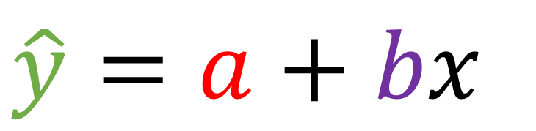
$$\hat{y}=a+bx$$

Slide 71
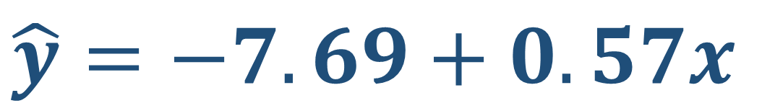
$$\hat{y}=a+bx$$
$$\hat{y}=−7.69+0.57x$$

Slide 72
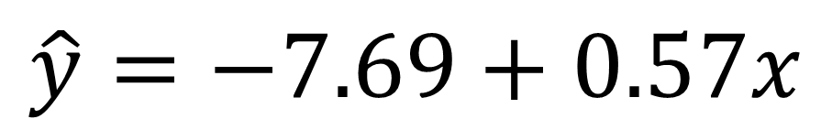
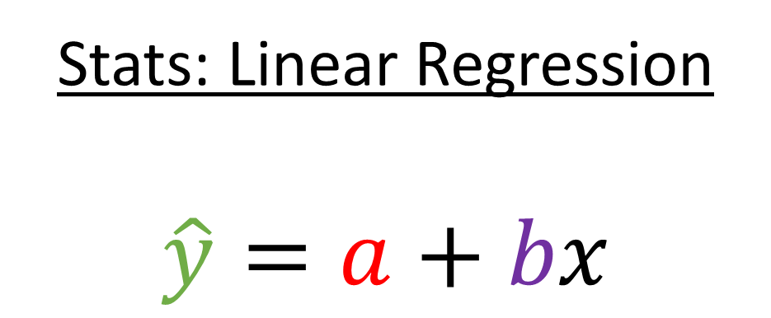
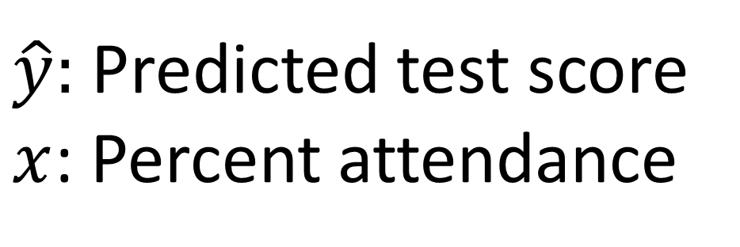
predicted y-value
Stats: Linear Regression
$$\hat{y}=a+bx$$
$$\hat{y}=−7.69+0.57x$$
$\hat{y}:$ Predicted test score
$x$: Percent attendance
Slope
y-intercept

Slide 73
predicted y-value
Stats: Linear Regression
$$\hat{y}=a+bx$$
$$\hat{y}=−7.69+0.57x$$
$\hat{y}:$ Predicted test score
$x$: Percent attendance
Slope
y-intercept

Slide 74
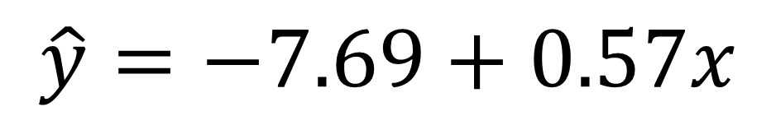
1) Interpret the slope value…
$$\hat{y}=−7.69+0.57x$$

Slide 75
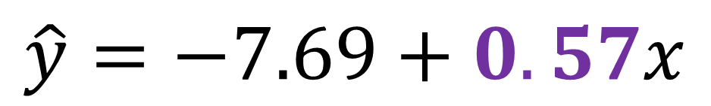
1) Interpret the slope value…
$$\hat{y}=−7.69+0.57x$$

Slide 76
1) Interpret the slope value…
$$\hat{y}=−7.69+0.57x$$
For every 1 unit increase in explanatory variable, our model predicts an average increase/decrease of slope in response variable.
Make sure to fill these with context and units!!!!!

Slide 77
1) Interpret the slope value…
$$\hat{y}=−7.69+0.57x$$
For every 1 unit increase in explanatory variable, our model predicts an average increase/decrease of slope in response variable.
For every 1 percentage point increase in attendance, our model predicts an average increase of 0.5669 points in students’ test scores.

Slide 78
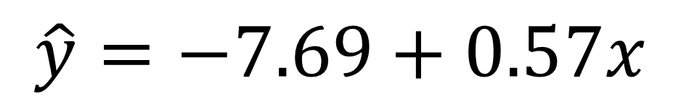
2) Interpret the y-intercept…
$$\hat{y}=−7.69+0.57x$$

Slide 79
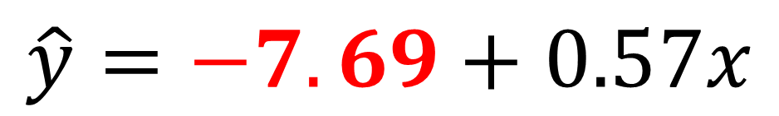
2) Interpret the y-intercept…
$$\hat{y}=−7.69+0.57x$$

Slide 80
2) Interpret the y-intercept…
$$\hat{y}=−7.69+0.57x$$
When the explanatory variable is zero units, our model predicts that the response variable would be y-intercept.
Make sure to fill these with context and units!!!!!

Slide 81
2) Interpret the y-intercept…
$$\hat{y}=−7.69+0.57x$$
When the explanatory variable is zero units, our model predicts that the response variable would be y-intercept.
When attendance is zero percent, our model predicts that the students’ test scores would be -7.689.

Slide 82
2) Interpret the y-intercept…
$$\hat{y}=−7.69+0.57x$$
When the explanatory variable is zero units our model predicts that the response variable would be y-intercept.
This y-int value is not meaningful, since anyone with 0% attendance doesn’t really go to the school or take the exam.
When attendance is zero percent our model predicts that the students’ test scores would be -7.689.

Slide 83
Topics
Least squares regression line (LSRL)
Slope and y-intercept
Predictions using the LSRL
Dangers of prediction

Slide 84
Superintendent: “If a student meets our minimum attendance goal (87%), what would their predicted test score be?”

Slide 85
y = ax + b
y = 2x + 1
Find the y-value when x = 2:

Slide 86
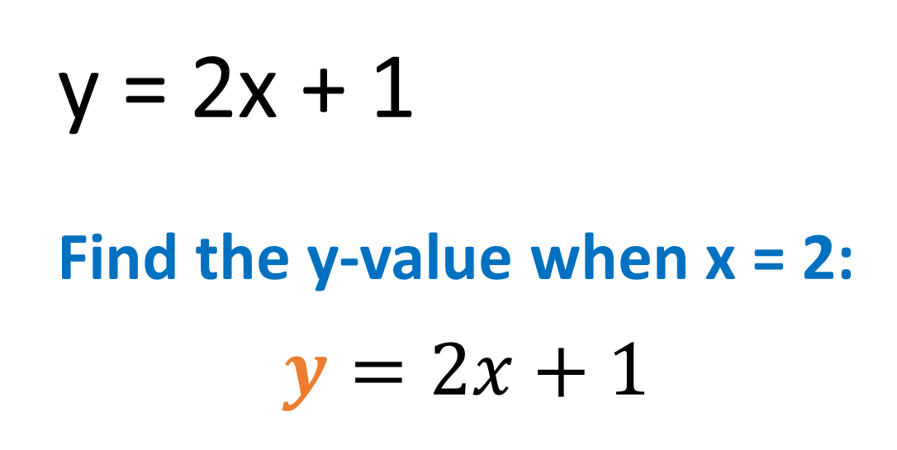
y = ax + b
y = 2x + 1
Find the y-value when x = 2:
$$y=2x+1$$

Slide 87
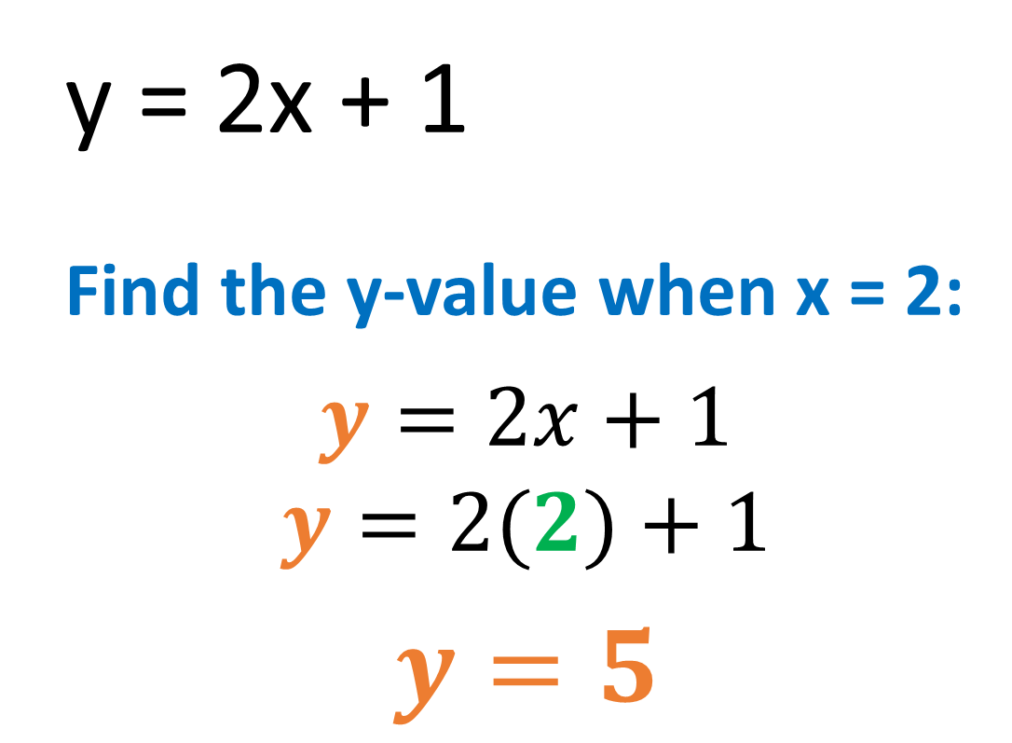
y = ax + b
y = 2x + 1
Find the y-value when x = 2:
$$y=2x+1$$
$$y=2(2)+1$$
$$y=5$$
y = 5
x = 2

Slide 88
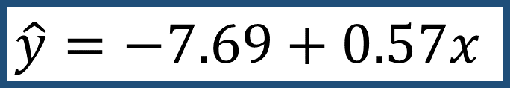
Superintendent: “If a student meets our minimum attendance goal (87%), what would their predicted test score be?”
$$\hat{y}=−7.69+0.57x$$

Slide 89

Superintendent: “If a student meets our minimum attendance goal (87%), what would their predicted test score be?”
$$\hat{y}=−7.69+0.57x$$
$$\hat{y}=−7.69+0.57x$$

Slide 90
Superintendent: “If a student meets our minimum attendance goal (87%), what would their predicted test score be?”
$$\hat{y}=−7.69+0.57x$$
$$\hat{y}=−7.69+0.57x$$
x = 87

Slide 91

Superintendent: “If a student meets our minimum attendance goal (87%), what would their predicted test score be?”
$$\hat{y}=−7.69+0.57x$$
$$\hat{y}=−7.69+0.57x$$
$$\hat{y}=−7.69+0.57\left(87\right)$$
x = 87

Slide 92


Superintendent: “If a student meets our minimum attendance goal (87%), what would their predicted test score be?”
$$\hat{y}=−7.69+0.57x$$
$$\hat{y}=−7.69+0.57x$$
$$\hat{y}=−7.69+0.57\left(87\right)$$
$$\hat{y}=41.9 points$$
$\hat{y}$ = 41.9
x = 87

Slide 93
Topics
Least squares regression line (LSRL)
Slope and y-intercept
Predictions using the LSRL
Dangers of prediction

Slide 94
What to watch out for !!!
Extrapolation:
Predicting a response variable for something that is significantly outside the range of x values that you have.
You can not predict too far into the future or past.
Correlation is totally not causation!!!

Slide 95
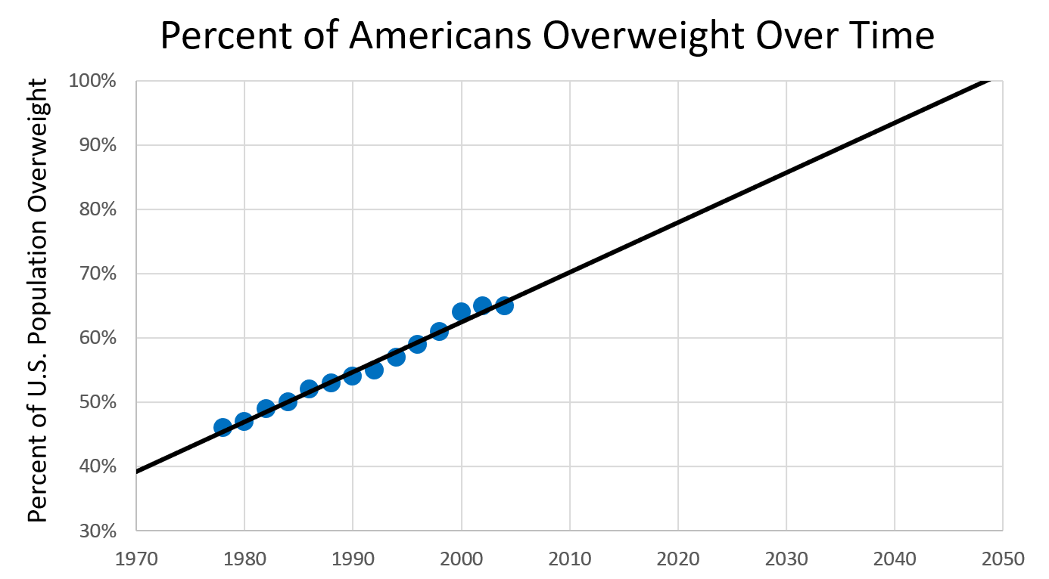
Extrapolation: using your model to make predictions outside the range of your data.

Slide 96
Extrapolation is dangerous because the trend may not continue.
Extrapolation: using your model to make predictions outside the range of your data.

Slide 97
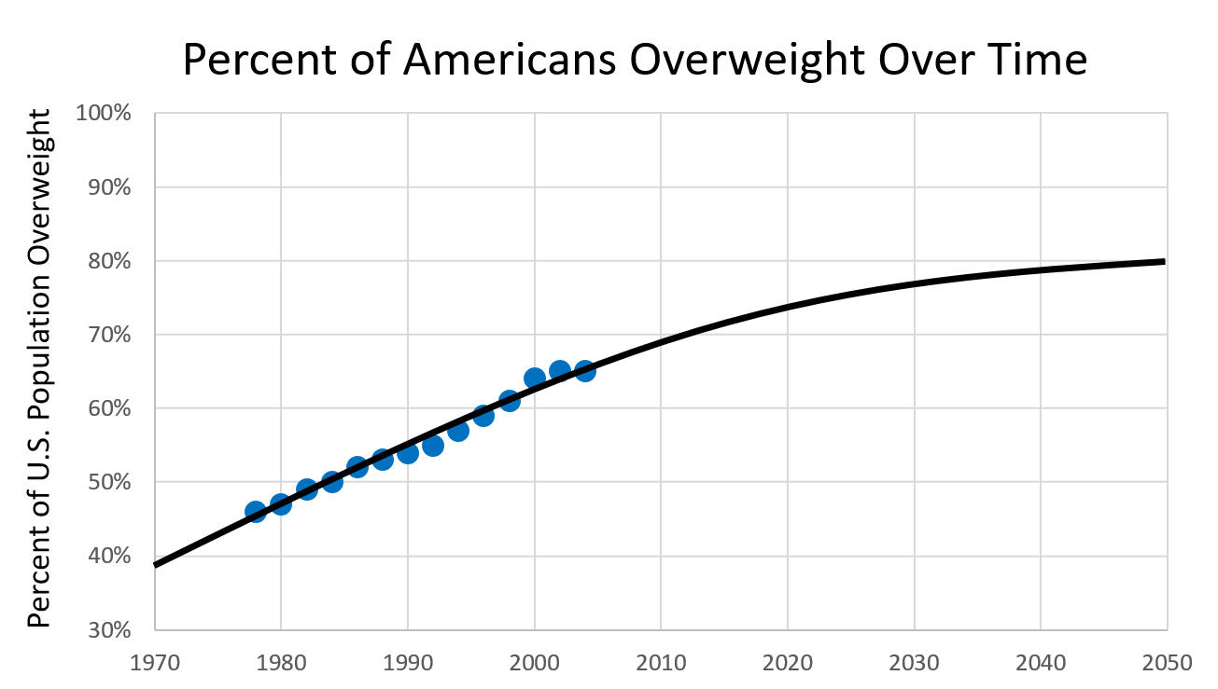
Extrapolation is dangerous because the trend may not continue.
This logarithmic model is more reasonable – it’s improbable that every single person in the population would become overweight.

Slide 98
Is attendance the solution?
Poverty
High
Will raising attendance also raise scores?
Low Attendance
High
Low Scores

Slide 100
Of course attending school helps!

Slide 101
Fixing attendance
In the past several years, superintendents have piloted large-scale (and sometimes quite expensive) initiatives to improve student attendance. These included:
Call programs for chronically absent students
Hiring attendance case managers and coordinators
Using Uber/Lyft for students with transportation issues

Slide 102
The result
Attendance
Pyne, Grodsky, et al., (2018). What Happens When Children Miss School? Unpacking Elementary School Absences in MMSD. Madison, WI: Madison Education Partnership.

Slide 103
The result
Test Scores
Pyne, Grodsky, et al., (2018). What Happens When Children Miss School? Unpacking Elementary School Absences in MMSD. Madison, WI: Madison Education Partnership.

Slide 104

The result
Test Scores
Pyne, Grodsky, et al., (2018). What Happens When Children Miss School? Unpacking Elementary School Absences in MMSD. Madison, WI: Madison Education Partnership.

Slide 105
The result
1. Test scores overall did not rise significantly
2. The achievement gaps remained
Pyne, Grodsky, et al., (2018). What Happens When Children Miss School? Unpacking Elementary School Absences in MMSD. Madison, WI: Madison Education Partnership.

Slide 106
Discussion

Slide 107
Poverty
High
Low Attendance
High
Low Scores

Slide 108
Discussion Question: Why didn’t raising attendance work?
Poverty
High
Low Attendance
High
Low Scores

Slide 109
Correlation ≠ Causation

Slide 110
Is attendance the solution?
Poverty
Low Attendance
Low Scores

Slide 111
Is attendance the solution?
Poverty
Hunger
Worse Schools
Less Study Time (job, taking care of family)
Low Attendance
Low Scores

Slide 112
Is attendance the solution?
Poverty
Hunger
Worse Schools
Less Study Time (job, taking care of family)
Low Attendance
Cause
Low Scores

Slide 113
Is attendance the solution?
Poverty
Hunger
Worse Schools
Less Study Time (job, taking care of family)
High
Low Attendance
Cause
Low Scores

Slide 114
Is attendance the solution?
Poverty
Hunger
Worse Schools
Less Study Time (job, taking care of family)
High
Low Attendance
Cause
Low Scores

Slide 115
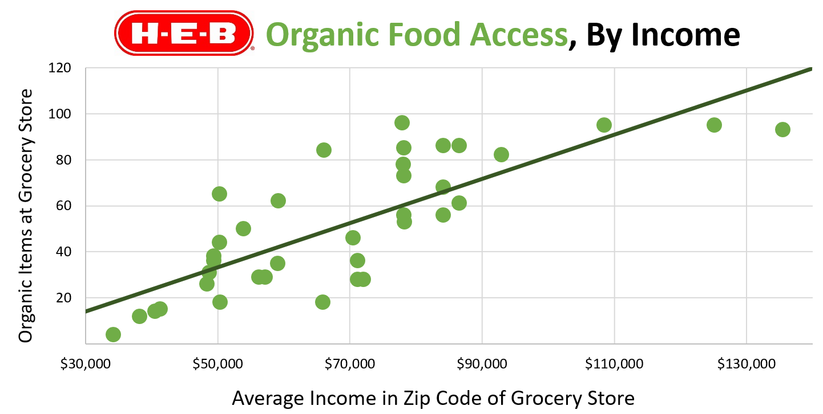
A logarithmic fit may be better for the grocery store data from last lesson. Presumably, the grocery chain has an upper limit on the organic options it can provide from its supply chains.

Slide 116
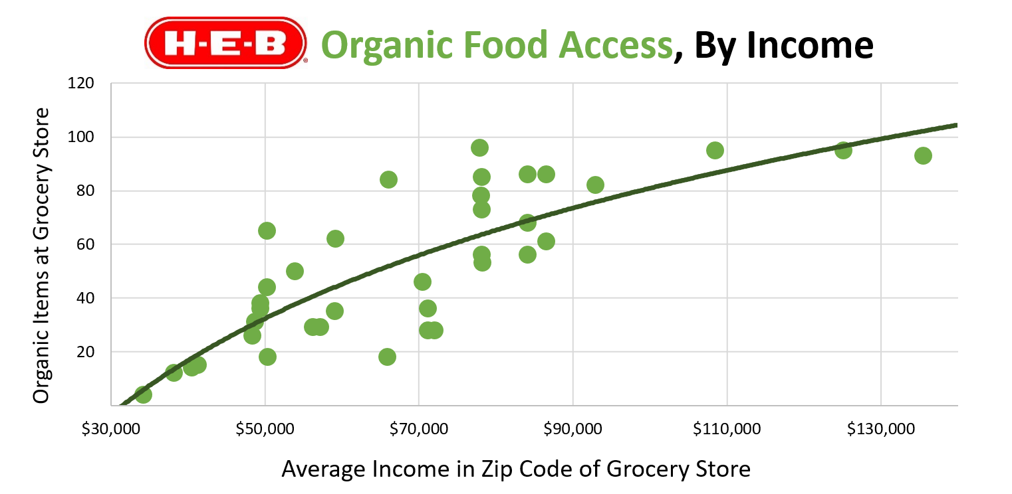
A logarithmic fit may be better for the grocery store data from last lesson. Presumably, the grocery chain has an upper limit on the organic options it can provide from its supply chains.

